Slide 1
JRugged: Successfully Planning for Failure
Joe Campbell
Senior Software Architect
Comcast Interactive Media

Slide 2
sh-3.2# whoami
“Professional” Programmer for ~15 years
Main job is to help developers “GO FAST”
Find good ways to accomplish great things
Pragmatism

Slide 3
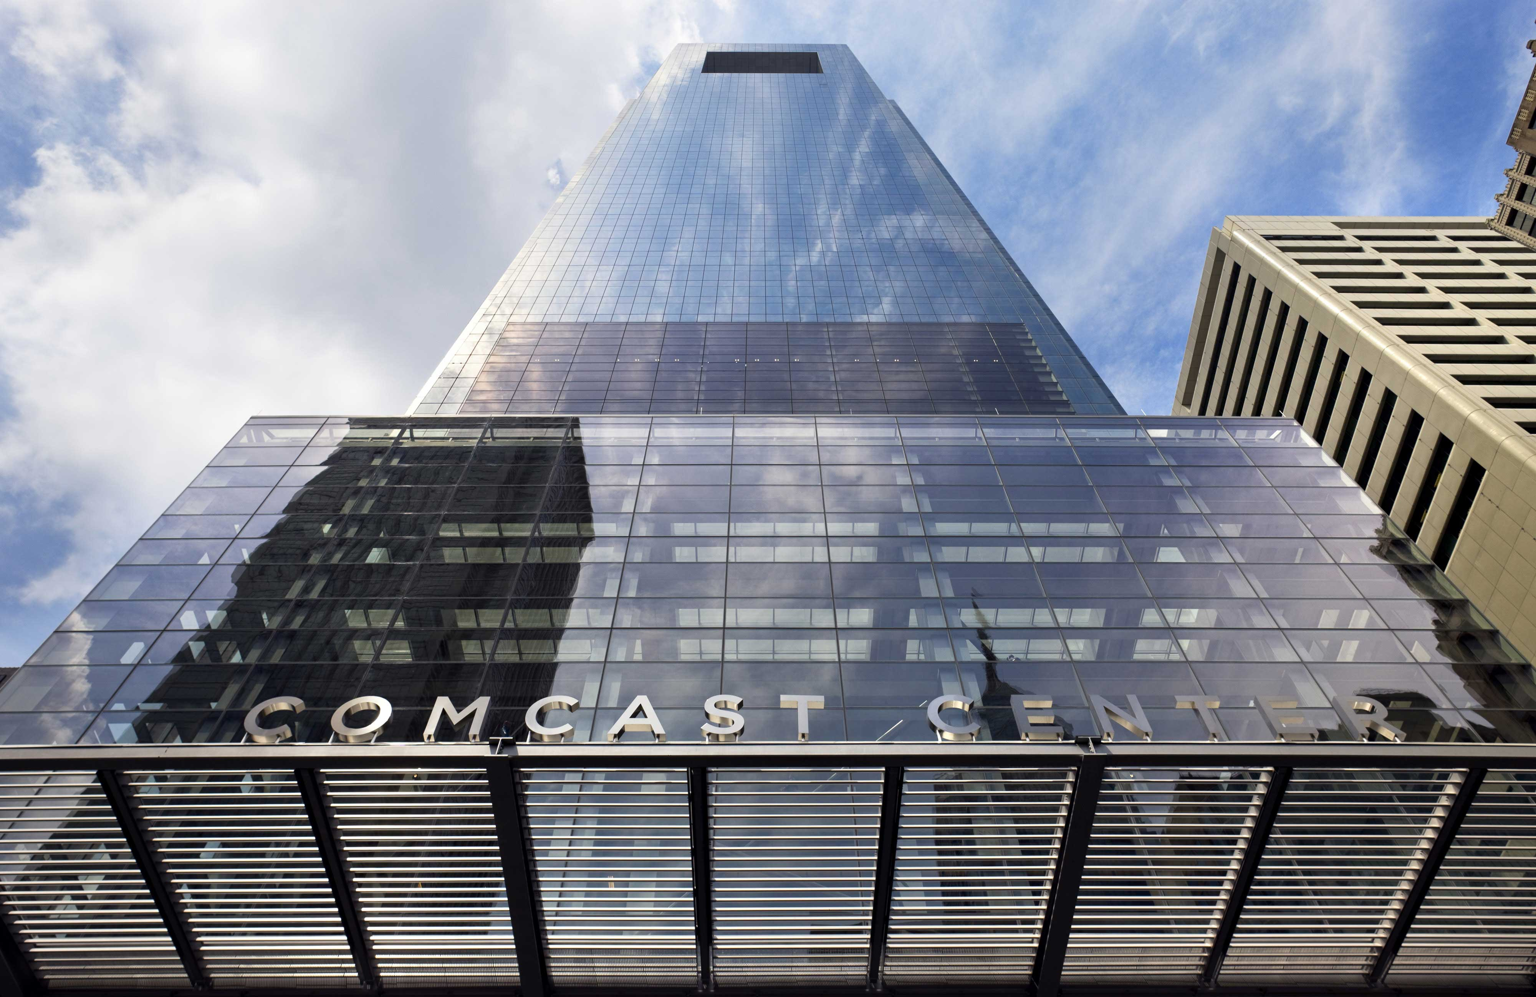
sh-3.2# whoami
Photo by Peter Aaron/Esto

Slide 4
sh-3.2# whoami
http://www.resourcesforlife.com/docs/item1424

Slide 5
Lets talk about…
FAILURE

Slide 6
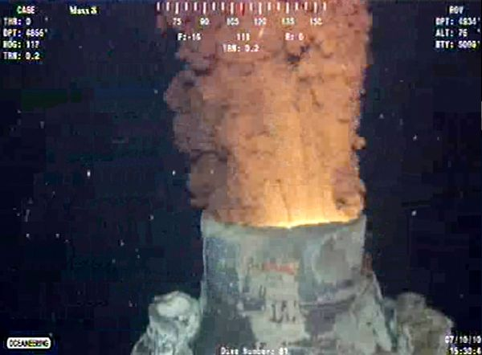
http://news.nationalgeographic.com/news/2010/07/photogalleries/100715-bp-containment-cap-nation-gulf-oil-spill-leak-pictures/#/bp-oil-well-new-cap-gushing_23455_600x450.jpg

Slide 7
http://www.eoearth.org/article/Three_Mile_Island,_Pennsylvania
Notes:
mistakes made by employees, faulty plant design, and the breakdown of key elements in the proper operation of the plant

Slide 8
The inevitable backhoe problem…
http://www.wktelecom.coop/QNAMii/userfiles/Image/call_before_you_dig.jpg
Notes:
Network partitions,

Slide 9
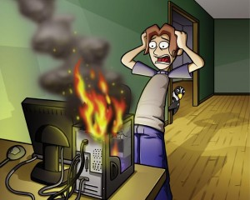
http://nerdynerds.net/

Slide 10
The early morning call…
Image from: http://www.crunchgear.com/wp-content/uploads/2009/01/cranky-early-morning-1.jpg

Slide 11
Lets talk about…
JRUGGED
Notes:
Note the closing presentation from Surge 2010 and Theo Schlosnagle

Slide 12
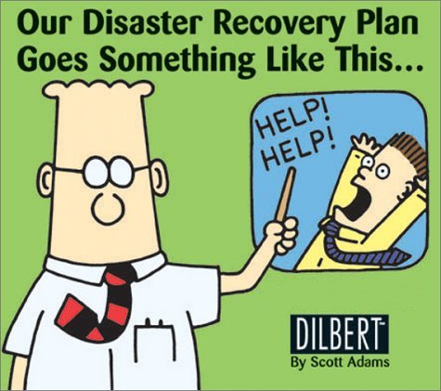
Thou shalt always remain recoverable
The 10 commandments of webscale: http://s.omniti.net/surge/i/content/slides/ClosingPlenary.pdf
http://www.lakecountyohio.org/ema/EMAHome/Recovery/tabid/1321/Default.aspx

Slide 13
Test what happens…
http://www.universalhub.com/2010/entire-red-line-dead
Notes:
Netflix has the chaos monkey, a script/tool that randomly kills services/servers to see what happens.

Slide 14
Human Intervention
Only in the most dire of emergencies
Design the system to never need to be ‘Touched’ by a human
Operator error can lead to ‘increased’ disaster levels

Slide 15
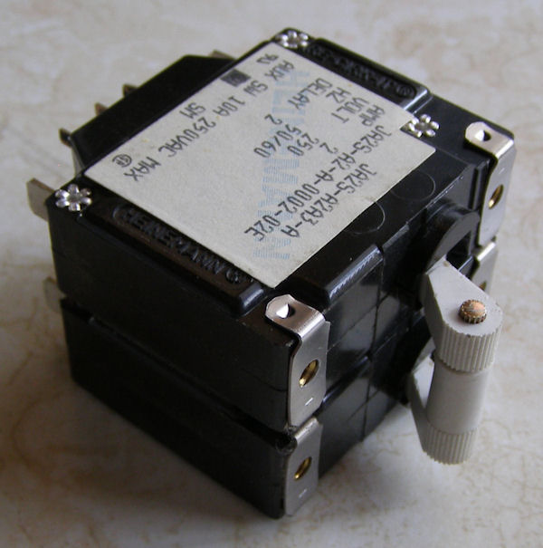
CircuitBreaker
http://www.electronicpeasant.com/tpost/items/breaker03.jpg
Notes:
Prevent your system from “over heating”
Configurable
number of failures per unit time
Rest period/reset period
What should I ignore (what exceptions are ‘normal’ to get)

Slide 16
How it works…
CircuitBreaker
Caller
CircuitBreakerException
Open
Breaker
Exception
Yes
Breaker
Open?
Wrapped
Method
NO

Slide 17
That which cannot be measured cannot be scaled
The 10 commandments of webscale: http://s.omniti.net/surge/i/content/slides/ClosingPlenary.pdf

Slide 18
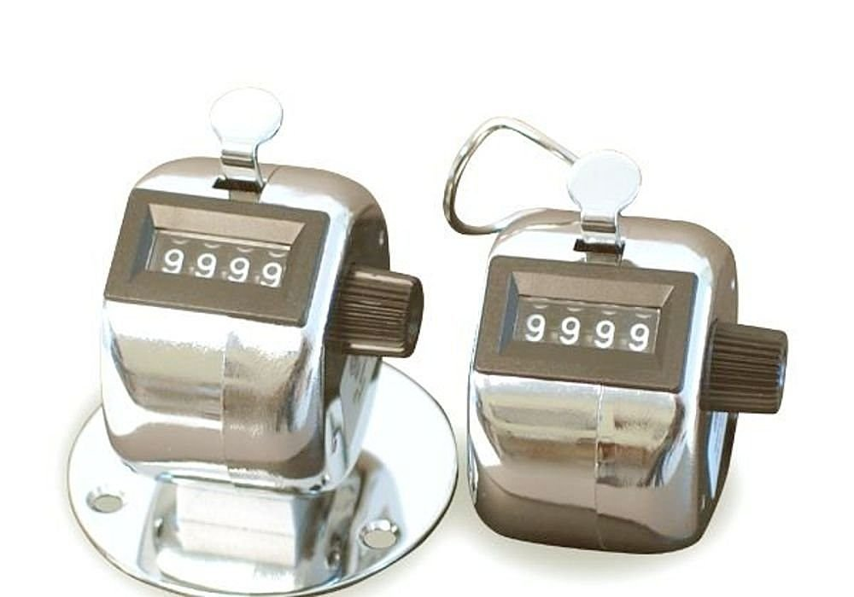
How many? (RequestCounter)

Slide 19
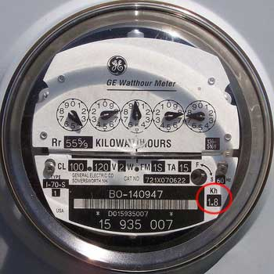
How much (per unit time)? (FlowMeter)
http://www.efundies.com/electricity/how_to_read_power_meter.htm
Notes:
FlowMeter

Slide 20
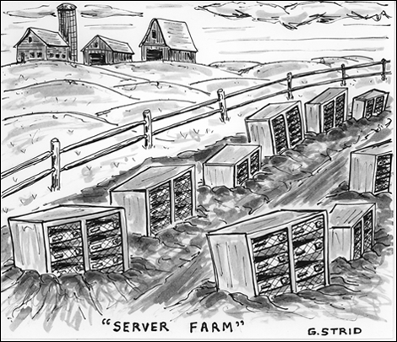
How fast? (LatencyTracker)
Request In
Latency
Response Out
http://splendidmarbles.com/2009/02/04/cartoons/server-farm-a-new-cartoon
Notes:
The latency tracker is a server only tracker (i.e. it is only tracking the latency of a wrapped method call)

Slide 21
Statistics for good measure… (MovingAverage)
Average
http://www.bungobox.com/wp-content/uploads/2010/05/two-cartoon-movers-with-sofa.jpg

Slide 22
PerformanceMonitor
http://blog.domaintools.com/2009/05/domaintools-improves-its-performance/

Slide 23
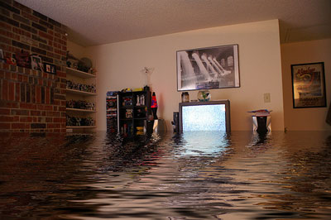
Operate even in the greatest of storms
The 10 commandments of webscale: http://s.omniti.net/surge/i/content/slides/ClosingPlenary.pdf
http://www.flood-pictures.com/how-to-dry-out-your-flooded-house/
Notes:
Netflix Rambo Mode – servers can succeed all on their own

Slide 24
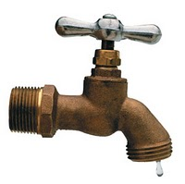
ConstantFlowRegulator
http://tangerinetoad.blogspot.com/2010/06/getting-right-hands-on-spigot.html

Slide 25
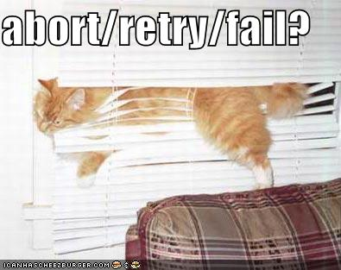
ServiceRetrier

Slide 26
Status/RolledUpStatus
http://www.spanishdict.com/answers/151153/la-palabra-del-da-el-semforo

Slide 27
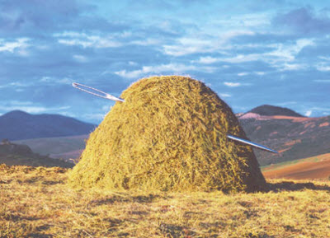
So what if…
http://venturebeat.com/2010/08/27/discoverybeat-needle-in-the-haystack-business-contest/

Slide 28
The Needle
http://stillsupplanting.blogspot.com/2010/10/443-bugle-call.html
Notes:
Capacity of these things plays a role

Slide 29
Packaging
Core
Aspects
Spring
HTTP Client
http://www.freevector.com/site_media/preview_images/FreeVector-Four-Elements-Fighters.jpg

Slide 30
Decorator Pattern
Core components follow the decorator pattern
http://www.stripedogdesigns.co.uk/illustration/decorator.html

Slide 31
Decoration Example
public BackEndData processArgument(final String myArg) { final BackEndService theBackend = backend;
public BackEndData call() throws Exception {
return perfMonitor.invoke(new Callable<BackEndData>() { public BackEndData call() throws Exception { return theBackend.processArgument(myArg); } });
}
}

Slide 32
Lets talk about…
DEMO

Slide 33
Conclusions
Prepare for anything
Test the disaster/impossible regularly
CircuitBreakers can help deal with odd situations
JRugged helps you code your applications to know about their environment
Status and CircuitBreakers
Notes:
Doesn’t mention Jrugged?

Slide 34
Conclusions
JRugged helps you to avoid as much Human Intervention as possible
JRugged metrics provide you an understanding of how your application behaves normally or when under pressure
PerformanceMonitors and Statistics
JRugged makes application instrumentation so easy it becomes criminal NOT to use/add it.
Notes:
Doesn’t mention Jrugged?

Slide 35
The juicy bits
GO GET THE CODE!!
http://code.google.com/p/jrugged/
C# port in the works
http://code.google.com/p/nrugged/
Other ports?

Slide 36
Close out
Twitter: @joercampbell
Email: joseph_campbell@comcast.com
Blog: http://ponderousprog.blogspot.com
Props: http://s.omniti.net/surge/i/content/slides/ClosingPlenary.pdf

Slide 37
DEMO
LOW FI

Slide 38
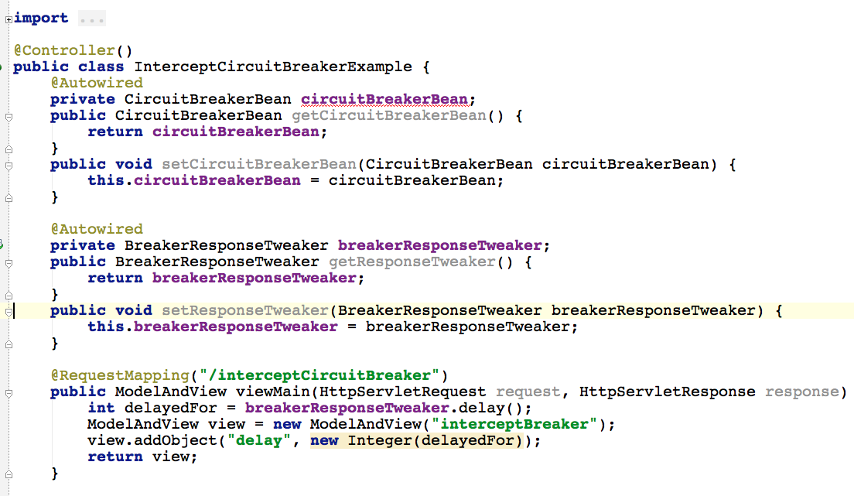
Our Webapp controller (Spring MVC)

Slide 39
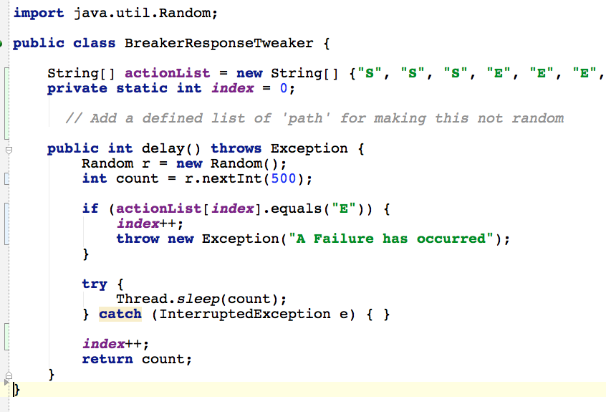
Our ‘Business’ logic

Slide 40
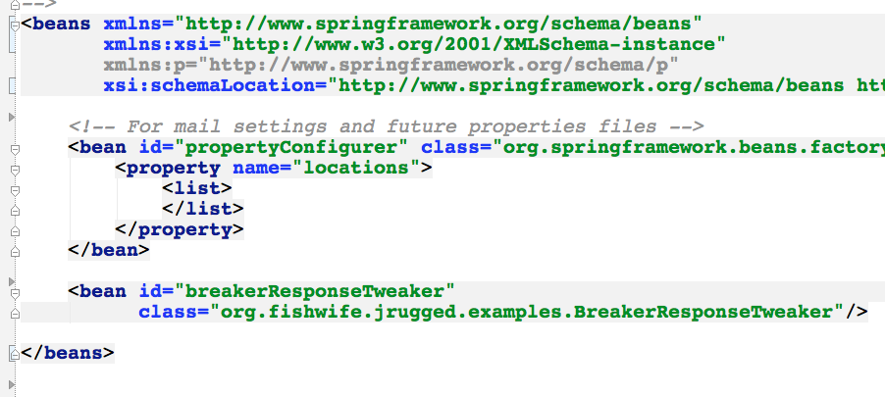
The starting point

Slide 41
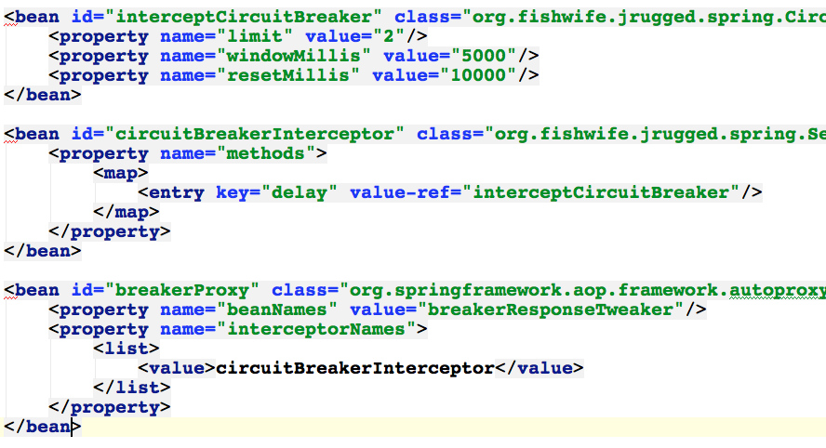
Add proxy information and Breaker config

Slide 42
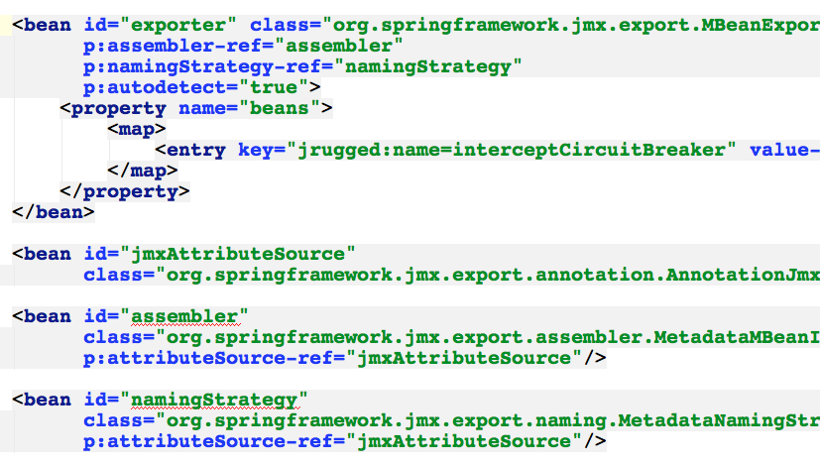
ADD JMX Publishing

Slide 43
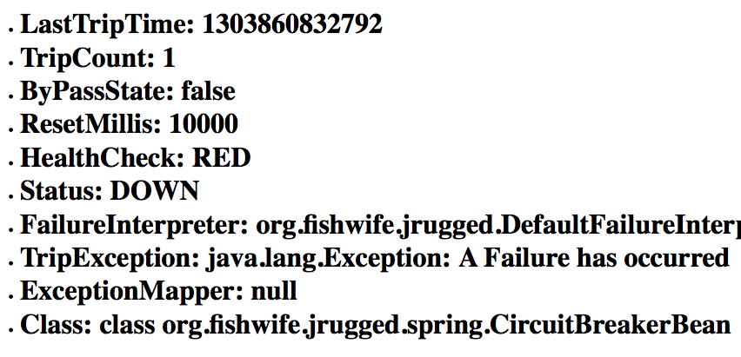

Slide 44
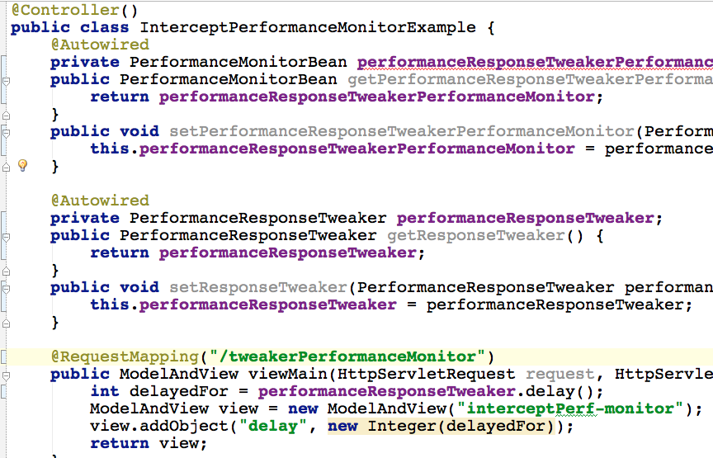
Our Webapp controller (Spring MVC)

Slide 45
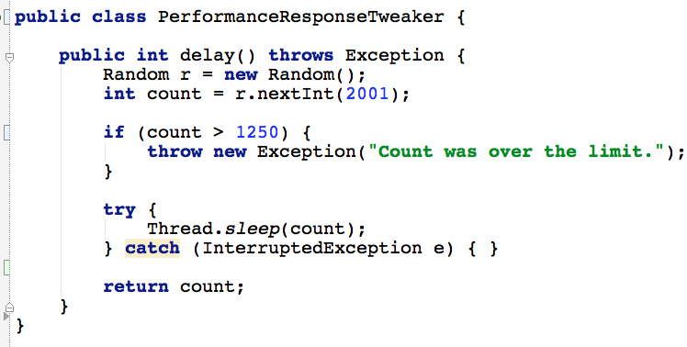
Our ‘Business’ logic

Slide 46
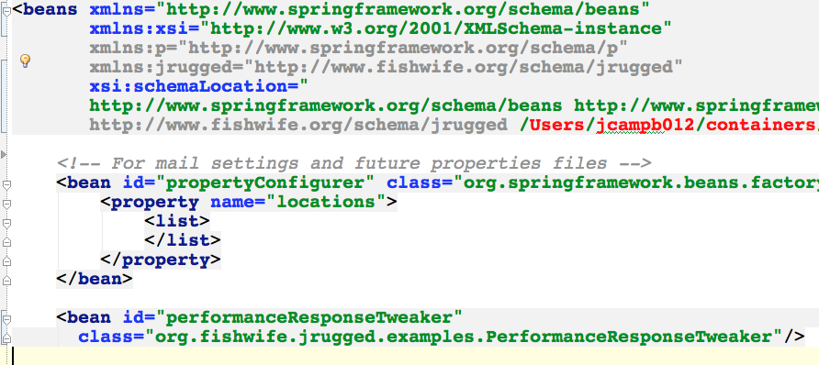
The starting point

Slide 47
OMG IT CAN’T BE THAT EASY!
HELL YES –
ITS THAT EASY!

Slide 48
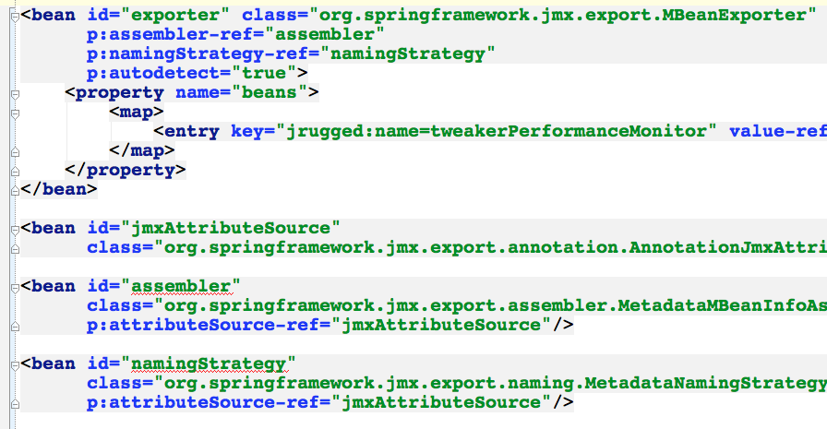
ADD JMX Publishing

Slide 49
